Slide 1

SEN101
Introduction to Computing and Application Lecture 1: Data storage: data representation, data storage, types of data store in a computer.
Ibrahim Abdullahi
Nile University of Nigeria, Abuja
Faculty of Natural and Applied Science Department of Software Engineering
© Adopted from Umar Adam Ibrahim
Notes:
Computing is any goal-oriented activity requiring, benefiting from, or creating computing machinery. It includes study of algorithmic processes and development of both hardware and software. It has scientific, engineering, mathematical, technological and social aspects.

Slide 2
Bit and their storage
First, we must consider how information can be stored inside computers. By “information” we mean the following
Numbers
Text
Images ……. All stored in binary
Sound
Video, etc.
For todays’ computers, information is encoded as patterns of 0’s and 1’s called bits (short for binary digits).
The reason we use only two symbols (0 and 1) for information encoding is because it’s simple, not because it’s powerful.
2
©

Slide 3
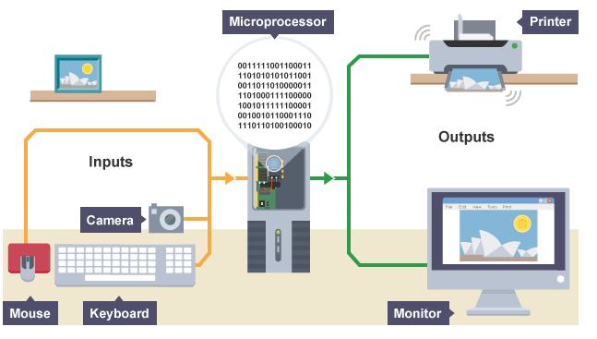
The Concept

Slide 4
Did you know?
In the early days of computing, the only way to enter data into a computer was by flicking switches or by feeding in punched cards or punched paper tape.
Since computers work using binary, with data represented as 1s and 0s, both switches and punched holes were easily able to reflect these two states - 'on' to represent 1 and 'off' to represent 0; a hole to represent 1 and no hole to represent 0.
Charles Babbage's Analytical Machine (in 1837) and the Colossus (used during the Second World War) were operated using punched cards and tapes. Modern computers still read data in binary form but it is much faster and more convenient to read this from microchips or from magnetic or optical disks.
(if you don’t know, now you know..)

Slide 5
Data representation
Some possible meanings for a single bit
Numeric value (1 or 0)
Boolean (true or false)
A bit can only represent one of two values, for more values, we need a long string of bits to represent them
Number conversions: An example, converting binary to base 10.
Binary, Decimal (base 10), Hexadecimal
101110 = 46. How??
©
5

Slide 6
Boolean operations
Operations that manipulate one or more 1/0 (or true/false) values are called Boolean operations, in honor of Mathematician George Boole (1815-1864).
The four Boolean operations are
AND
OR
XOR (exclusive or)
NOT
They are like arithmetic operators (+,-) because they combine a pair of value to produce a result
6
©

Slide 7
Boolean operations
AND result is true (1) when both of its component are true, we conclude 1 AND 1 should be 1, where as all other cases should produce an output of 0.
OR result is true (1) when at least one of its component is true, other cases should produce an output of 0.
XOR result is true (1) when its component are not the same.
NOT it compute only one input, if its input is true (1) the output should be false (0), otherwise if its false (0) the output will be true (1).
7
©

Slide 8
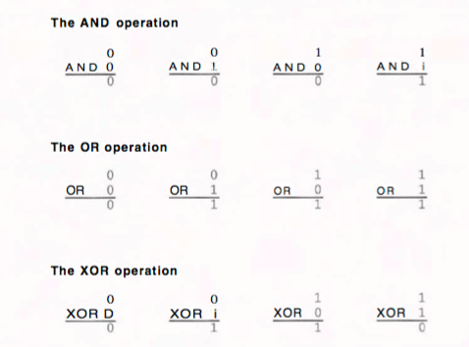
Example of Boolean operations
8
©

Slide 9
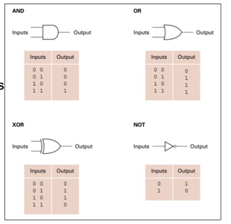
Gates
A device that produces the output of a Boolean operation when given the operation's input values is called a gate
Inside today's computers, gates are usually implemented as small electronic circuits in which the digits 0 and 1 are represented as voltage levels
9
©

Slide 10
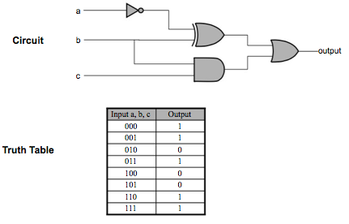
Gate example
A digital circuit’s operation can be summarized by a truth table
10
©

Slide 11
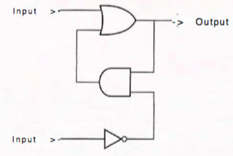
Flip-flop
A flip-flop is a circuit that produces an output value of 0 or 1, which remains constant until a temporary pulse from another circuit causes it to shift to the other value. Our purpose in introducing the flip-flop it demonstrates how devices can be constructed from gates, a process known as digital circuit design, which is an important topic in computer engineering
11
©

Slide 12
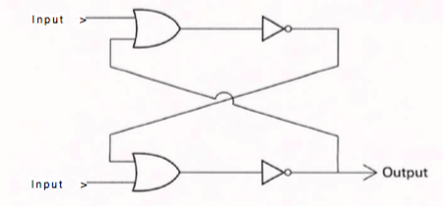
Another way of constructing flip-flop
Reasons for introducing Flip-flop
Construction device using gate
Provide example of abstraction
Alternative way of storing bits
12
©

Slide 13
Hexadecimal Notation
A long string (101101010011 ) of bits is called stream.
Stream are difficult for the human mind to comprehend. Therefore, the representation of such bit pattern is represented in short notation called hexadecimal notation.
Hexadecimal notation takes advantage of the fact that bit patterns within a machine tend to have lengths in multiples of four.
Example
101101010011. can be divided into the following:
1011 0101 0011
13
©

Slide 14
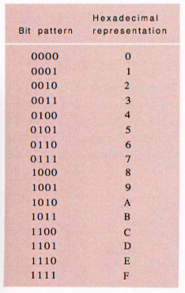
Hexadecimal encoding system
14
©

Slide 15
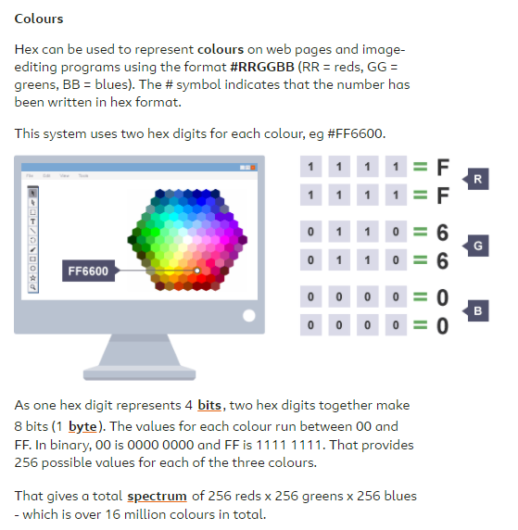

Slide 16

Main memory
A computer contains a large collection of circuits (such as flip-flops), each capable of storing a single bit. This bit reservoir is known as the machine's main memory.
Memory structure: Information is store in manageable units called a cell, each cell has a capacity of 8 bits which is equivalent to 1 byte.
Computers with small memory capacity may have a main memories consisting of a few hundred cells, whereas computers with large memory capacity may have billions of cells in their main memories.
Memory cell are arrangement in form of a row
16
©

Slide 17
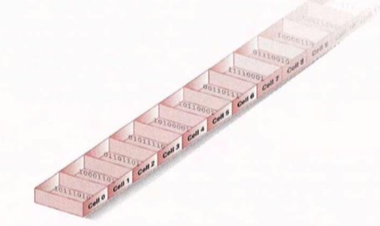
Main memory
How to identify individual cells in a computer main memory?
Assigning a unique address to every cell
17
©

Slide 18
Main memory
How can we access the content of memory cell?
Read operation
Write operation
the circuitry that actually holds the bits is combined with the circuitry required to allow other circuits to store and retrieve data from the memory cells. In this way, other circuits can get data from the memory by electronically asking for the contents of a certain address (called a read operation), or they can record information in the memory by requesting that a certain bit pattern be placed in the cell at a particular address (called a write operation).
18
©

Slide 19
Main memory
Why computer main memory is often called random access memory (RAM)?
Why some computers are faster than others?
Refresh circuit
Computers memory constructed from such technology is often called dynamic memory (DRAM) or Synchronous DRAM (SDRAM).
19
©

Slide 20
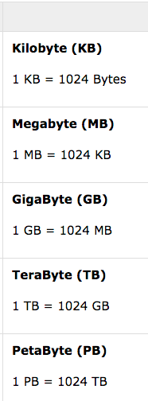
Unit of measuring memory capacity
Unit & Description
Bit (Binary digit)
A binary digit is logical 0 and 1 representing a passive or an active state of a component in an electric circuit.
Nibble
A group of 4 bits is called nibble.
Byte
A group of 8 bits is called byte
20
©

Slide 21
Mass Storage
Due to the limited storage capacity of main memory most computers have additional memory capacity called a mass storage (or secondary storage) such as the following:
Magnetic disks
CDs
DVDs
Flash drives, etc.
Advantage and disadvantage of mass storage?
Flexibility Motion (speed)
Terminologies used for differentiating the memory; on-line and off-line
©
21

Slide 22
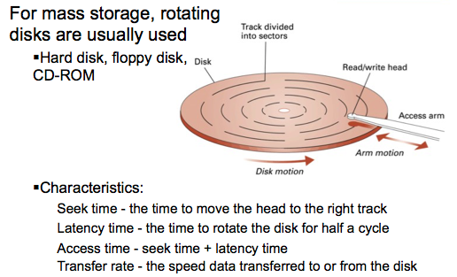
Disk storage system
22
©

Slide 23
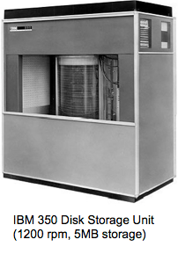
Mass storage system
Back in 1956, disk storage are huge
23
©

Slide 24
Flash drive
Flash memory technology has the potential of alleviating drawback of magnetic and optic technology storage that required physical motion. In a flash memory system, bits are stored by sending electronic signals directly to the storage medium where they cause electrons to be trapped in tiny chambers of silicon dioxide, thus altering the characteristics of small electronic circuits. Since these chambers are able to hold their captive electrons for many years, this technology is suitable for off-line storage of data.
24
©

Slide 25
Representing information as bit patterns
Text
Numerical data
Images
Sound
25
©

Slide 26

Representing text
Text Is represented by a code which is assigning a unique bit pattern to each character in a text. The text is then represented in a long string of bit.
Back in 1940s and 1950s there are several code that lead to communication problems. To overcome this situation the American Standard Code for Information Interchange (ASCII)
This code uses bit pattern of 7 length for upper, lowercase letters, tab, line break. Later extended to 8 bit pattern per symbol by adding a 0 at most significant end of each of the 7 bit pattern.
26
©

Slide 27
Representing numeric value
Number are encoded into bit 0 and 1 each digit in a group of 4 bit pattern.
# Bit
0 0000
1 0001
2 0010
3 0011
4 0100
5 0101
6 0110
7 0111
8 1000
9 1111
More precise later
27
©

Slide 28
Representing images
Image is represented as a collection of dot which called pixel, short for picture element.
A black and white image is then encoded as a long string of bits representing the rows of pixels in the image, where each bit is either 1 or 0 depending on whether the corresponding pixel is black or white. This is the approach used by many machines.
Color images; RGB encoding is used , leveraging on hexadecimal
Disadvantage of bit maps is rescaling. Enlarging image can be done by making pixel bigger that will lead to grainy appearance. Technique used in cameras’ “digital zoom” better technique is “optical zoom” that is obtained by adjusting lens.
Way to prevent grainy appearance is to encode the image in geometric structure (line and curves). Technique used by word processing to scale font text.
28
©

Slide 29
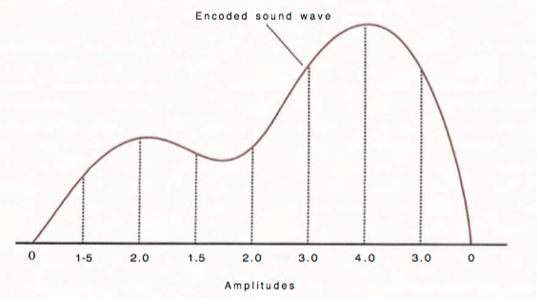
Representing sound (1)
The most generic method of encoding audio information for computer storage and manipulation is to sample the amplitude of the sound wave at regular intervals and record the series of values obtained. For instance, the series 0, 1.5, 2.0, 1.5, 2.0, 3.0, 4.0, 3.0, 0 would represent a sound wave that rises in amplitude, falls briefly, rises to a higher level, and then drops back to 0.
29
© Umar Adam Ibrahim

Slide 30
Representing sound (2)
Musical Instrumental Digital Interface (MIDI) is used in electronic keyboards, for video game sound, and for sound effects accompanying websites.
MIDI encode directions for producing sound rather than encoding the sound itself.
Analogous of encoding music sheet read by the performer rather than the music itself.
30
©

Slide 31
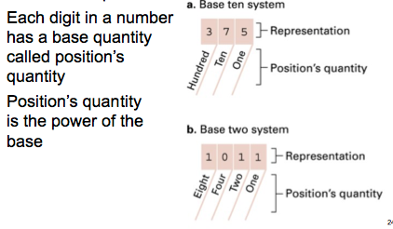
Binary notation
In previous slide, we saw that binary notation is a means of representing numeric values using only the digits 0 and 1 rather than the ten digits 0 through 9 that are used in the more common base ten notational system.
31
©

Slide 32
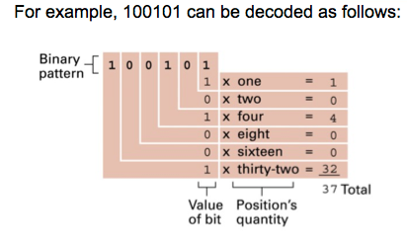
Conversion from radix 2 to radix 10
32
©

Slide 33
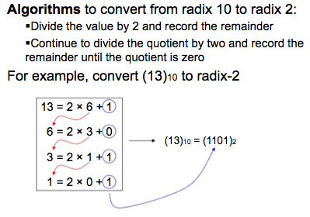
Conversion from radix 10 to radix 2
33
©

Slide 34
Summary
Information representation in computer and some operation on them.
Text
Images
Sound
Numeric
Memory of computer
Main memory
Mass storage (secondary storage)
Measure of memory capacity
34
© Umar Adam Ibrahim

Slide 35
Glimpse of next class
Computer architecture
The CPU basics
ALU
Control unit
Register unit
Machine instruction
Data transfer
ALU
Control
35
© Umar Adam Ibrahim

Slide 36
Question??
Thank you for coming.
36
© Umar Adam Ibrahim

